Slide 1
CEIS 114 Module 6
Creating a Multiple Traffic Light Controller with a Cross Walk and an Emergency Buzzer

Slide 2
Rubric – Due at the end of Week 6
Activity | Requirement(s) | Points
Include a picture of your circuit | Picture of the breadboard with LEDs ON and LCD displaying message | 20
Screenshot of code showing your name in comment | Screenshot of code in Arduino IDE showing your name in one of the comments | 20
Screenshot of output in Serial Monitor | Screenshot of Serial Monitor from Arduino IDE | 20

Slide 3
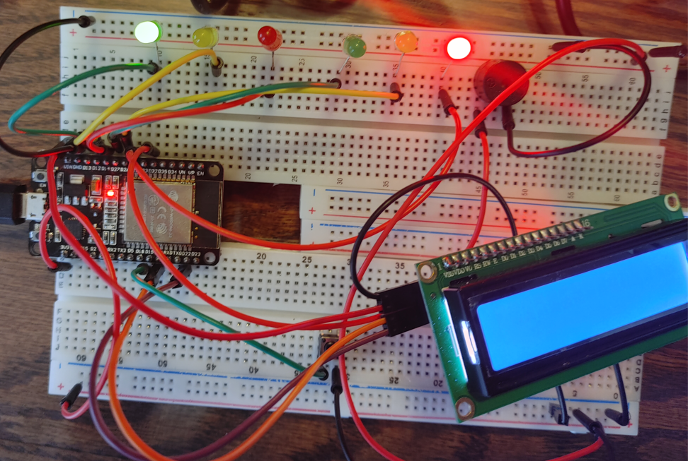
Picture of circuit with working LEDs and LCD display
ESP 32 Board
Colored LEDs: Red, Yellow and Green (two sets)
220 Ohm Resistors (optional)
Push Button
LCD Unit with Message Display
Wires
Breadboard

Slide 4
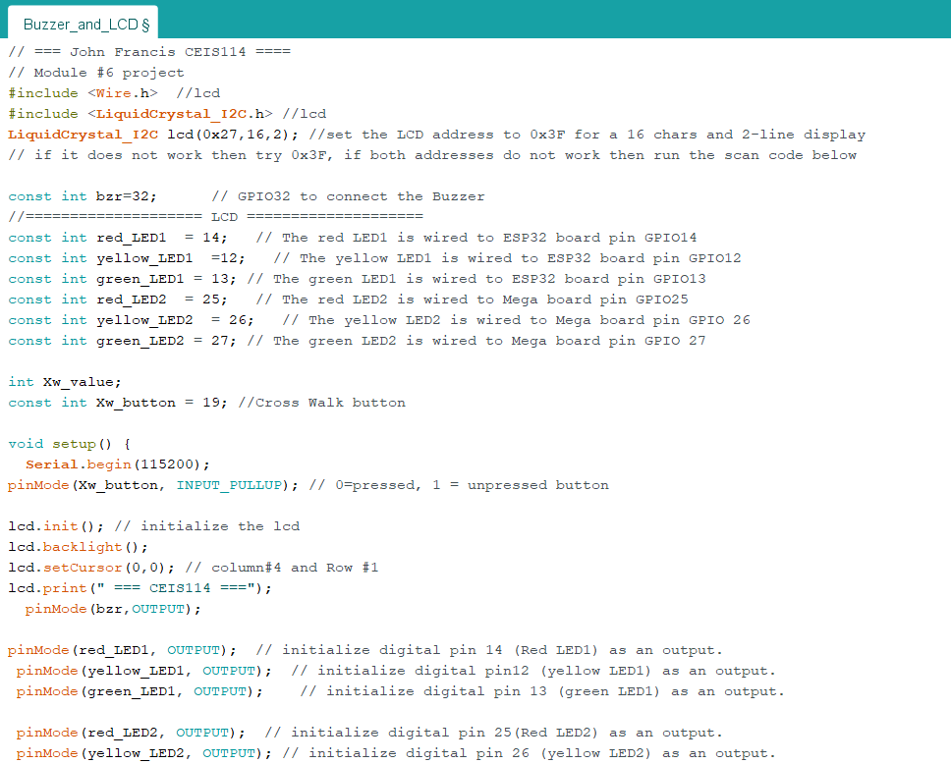
Screenshot of code in Arduino IDE
Screenshot of code in Arduino IDE showing your name in the comment

Slide 5
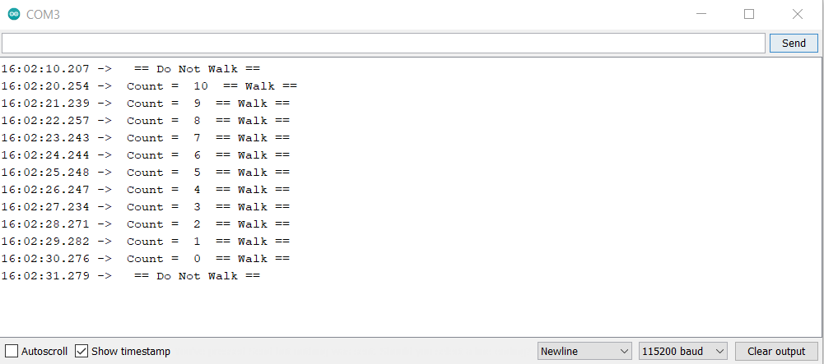
Screenshot of Serial Monitor in Arduino IDE
Screenshot of output in Serial Monitor

